Slide 1




Deep Learning for Traffic Flow Prediction
Presented by Karis Matchaparn
Advisor Prof. Yu-Ling Hsueh

Slide 2
Outline
Background
Objective
Traffic flow prediction model
Experiment result
Conclusion
Living & Traveling in Taiwan

Slide 3
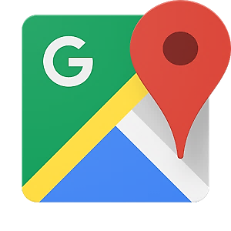
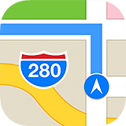
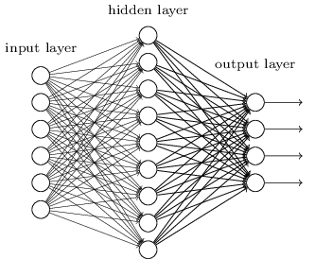
Background
Location-Based Service Technology
Travel planning support
Logistic support
Deep Learning
Finding hidden features from data
Training predicting model
Using Keras library and Theano backend

Slide 4
Research Objective
Construct a prediction model that collects the transportation data and predicts the traffic states (including car speed, and traffic congestion) during the period from 6.00 am to 9.00 am.
Short-term and Long-term Prediction
5-minute prediction
Any minute prediction
“Information ahead of time improves planning travel routes better”

Slide 5
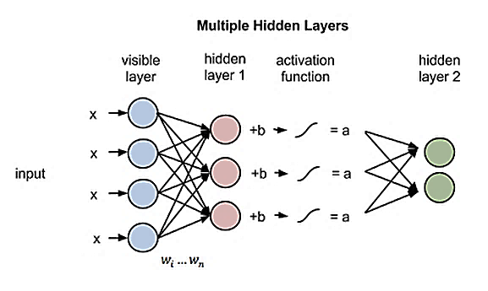
Restricted Boltzmann Machine
Visible layer and Hidden Layer
Restricted = no connection in the same layer
Stochastic Gradient Descent as the model’s optimizer
Sigmoid activation function

Slide 6
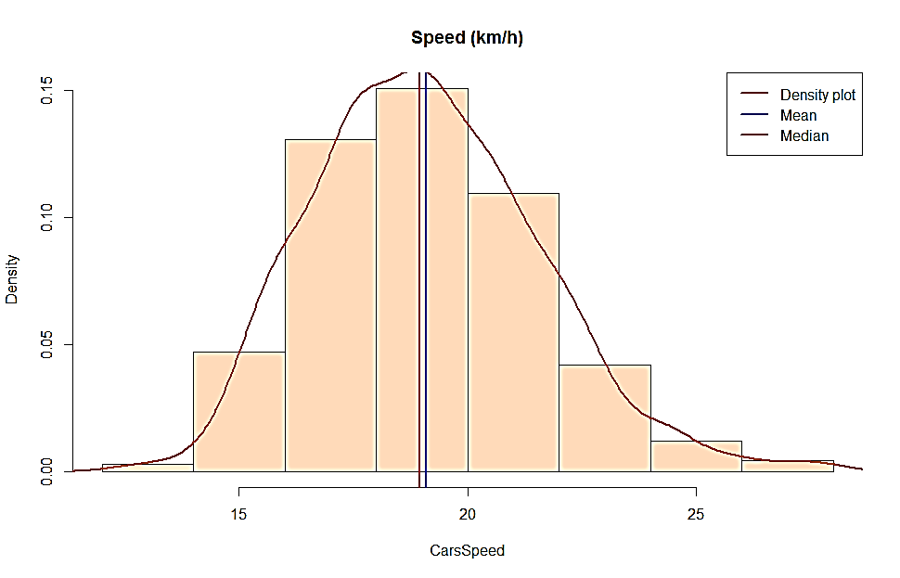
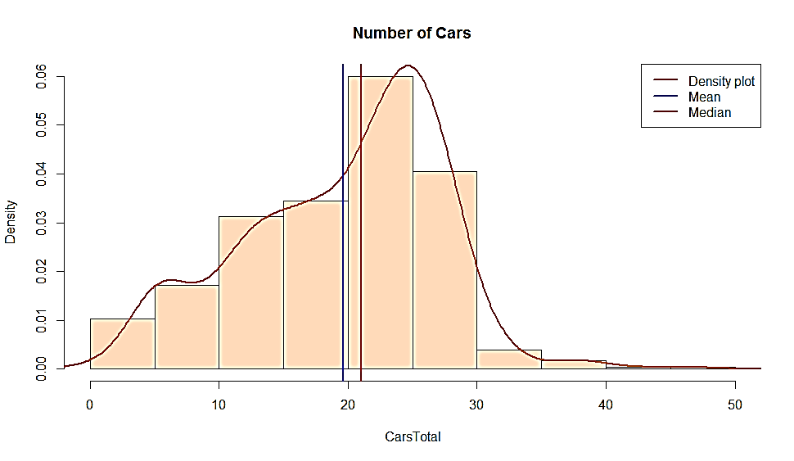
Methodology I
Dataset
Sensor data were collected from Taiwan’s highway.
Various features include Time, Speed, Number of cars,Weekday/Weekend.
Only data records in range of 6:00 a.m. to 9:00 a.m. are considered.
We use 75% of data as training data set and 25% of data as testing data set.
Data Pre-processing
Smoothing speed with LOWESS
Selecting speed which has Pearson correlation more than 0.8

Slide 7
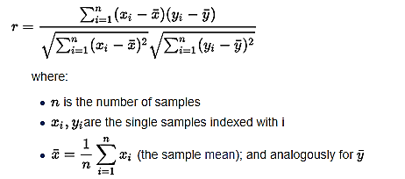
Methodology II
Pearson Correlation
Calculate linear correlation between two variables.
Value between -1 and +1

Slide 8
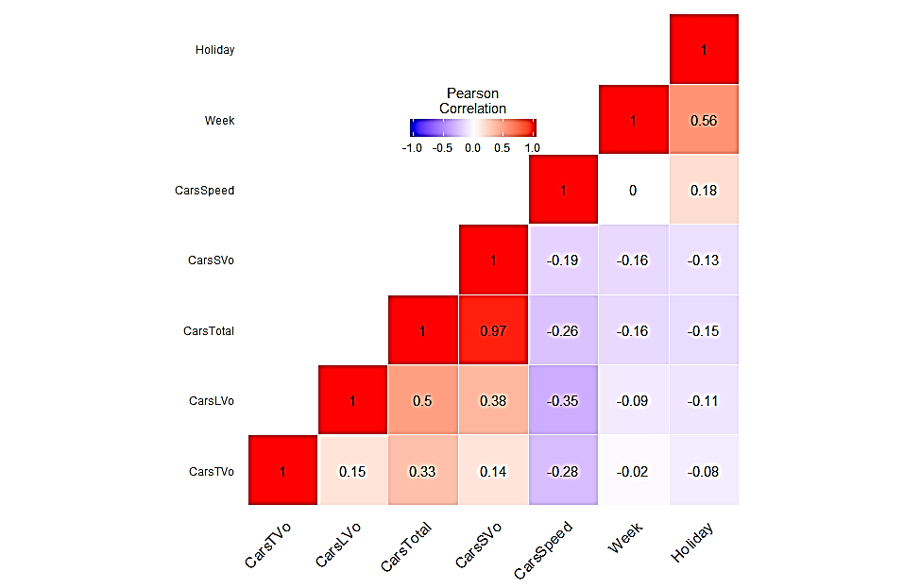
Methodology III
Feature Selection using Pearson Correlation
CarsSpeed : Average Speed of Cars on the road
- Correlation to CarsSpeed : 1
CarsTotal : Number of Cars in sensor’s range
- Correlation to CarsSpeed : -0.26
- Inverse of CarsSpeed
Weekend : Data in weekday or weekend
- Correlation to CarsSpeed : 0.18
Day
Weekend

Slide 9
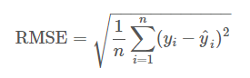
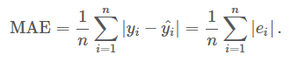
System Flow
Training dataset with CarsSpeed, CarsTotal, and Weekday/Weekend
Regularization
Trained RBM Model
Predicted Results
Training
Regularization
Testing dataset with CarsSpeed, CarsTotal, and Weekday/Weekend
Evaluated with ground-truth value
Root Mean Square Error
Mean Absolute Error
Accuracy, RMSE, MAE

Slide 10

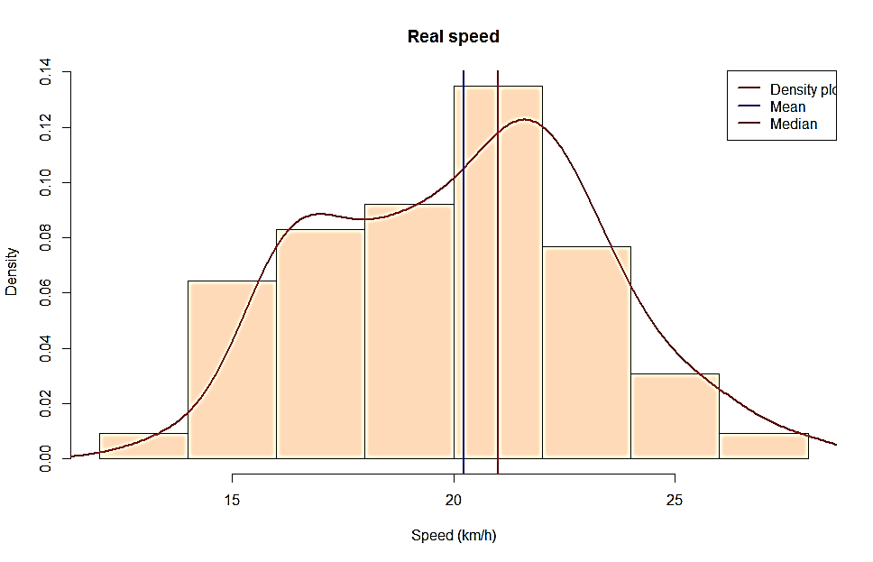
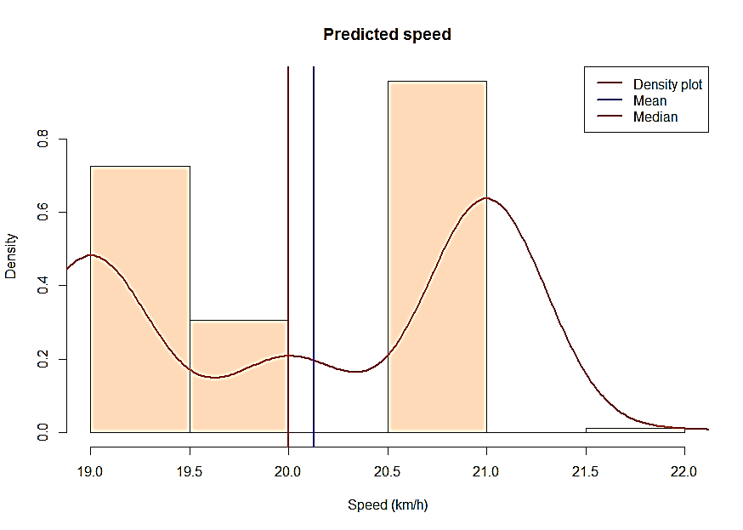
Experiment Results I
Example of speeds between real speed and predicted speed
10 examples
Real | 20 | 21 | 22 | 23 | 24 | 23 | 22 | 20 | 19 | 20
Predict | 21 | 21 | 19 | 19 | 19 | 19 | 19 | 19 | 20 | 20
Histogram of speeds
Mean
Mean

Slide 11
Experiment Results II
Compare real and predicted speed in weekday and weekend

Slide 12
3.48%
2.93%
Root Mean Squre Error (RMSE)
Mean Absolute Error

Slide 13
Conclusion
Prediction application can be built based on the RBM model to help plan and find the best route to reach the destination
The model can be achieved up to 95% accuracy.

Slide 14
Living and Traveling in Taiwan
Special thanks to..
Data Management Laboratory
Advanced Institute of Manufacturing with High- Tech Innovations
National Chung Cheng University
Dà chī restaurants, Family mart and 7-11

Slide 15

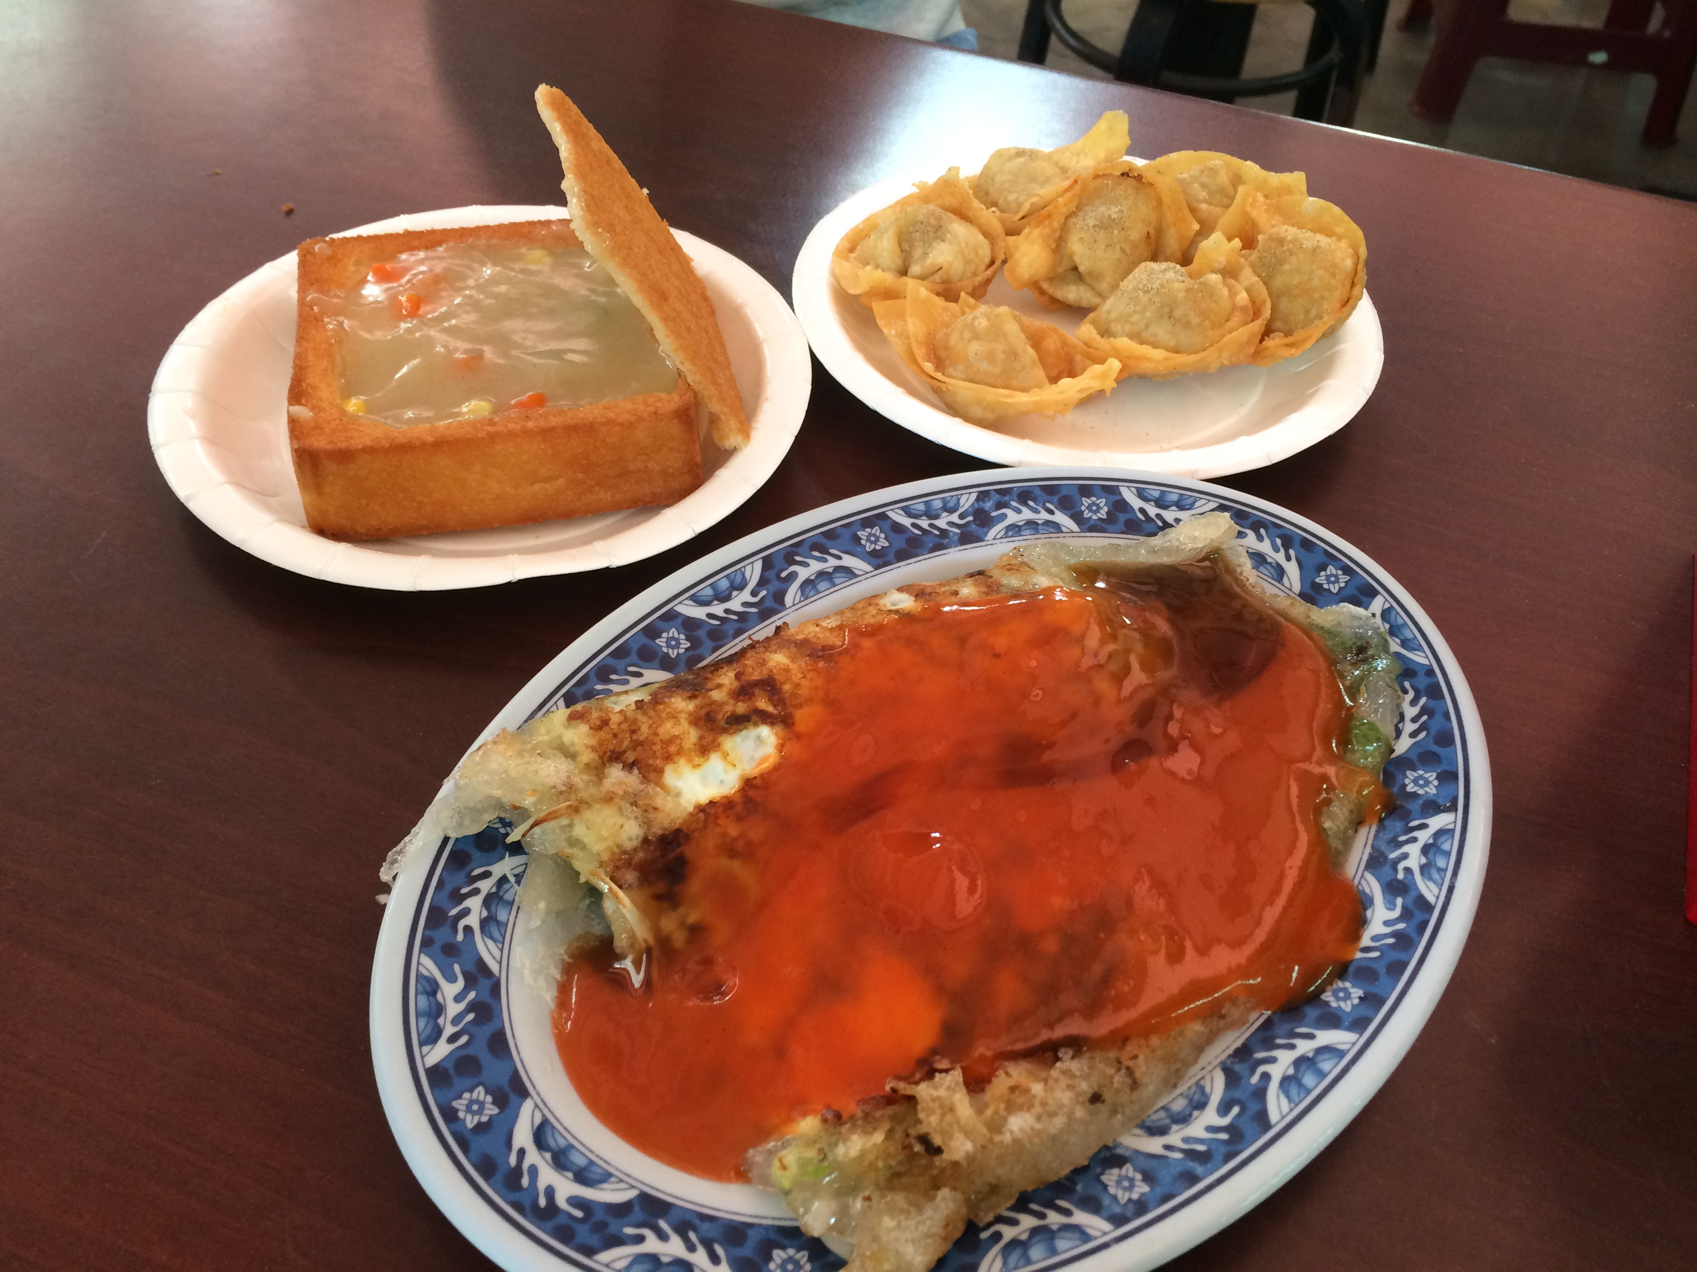
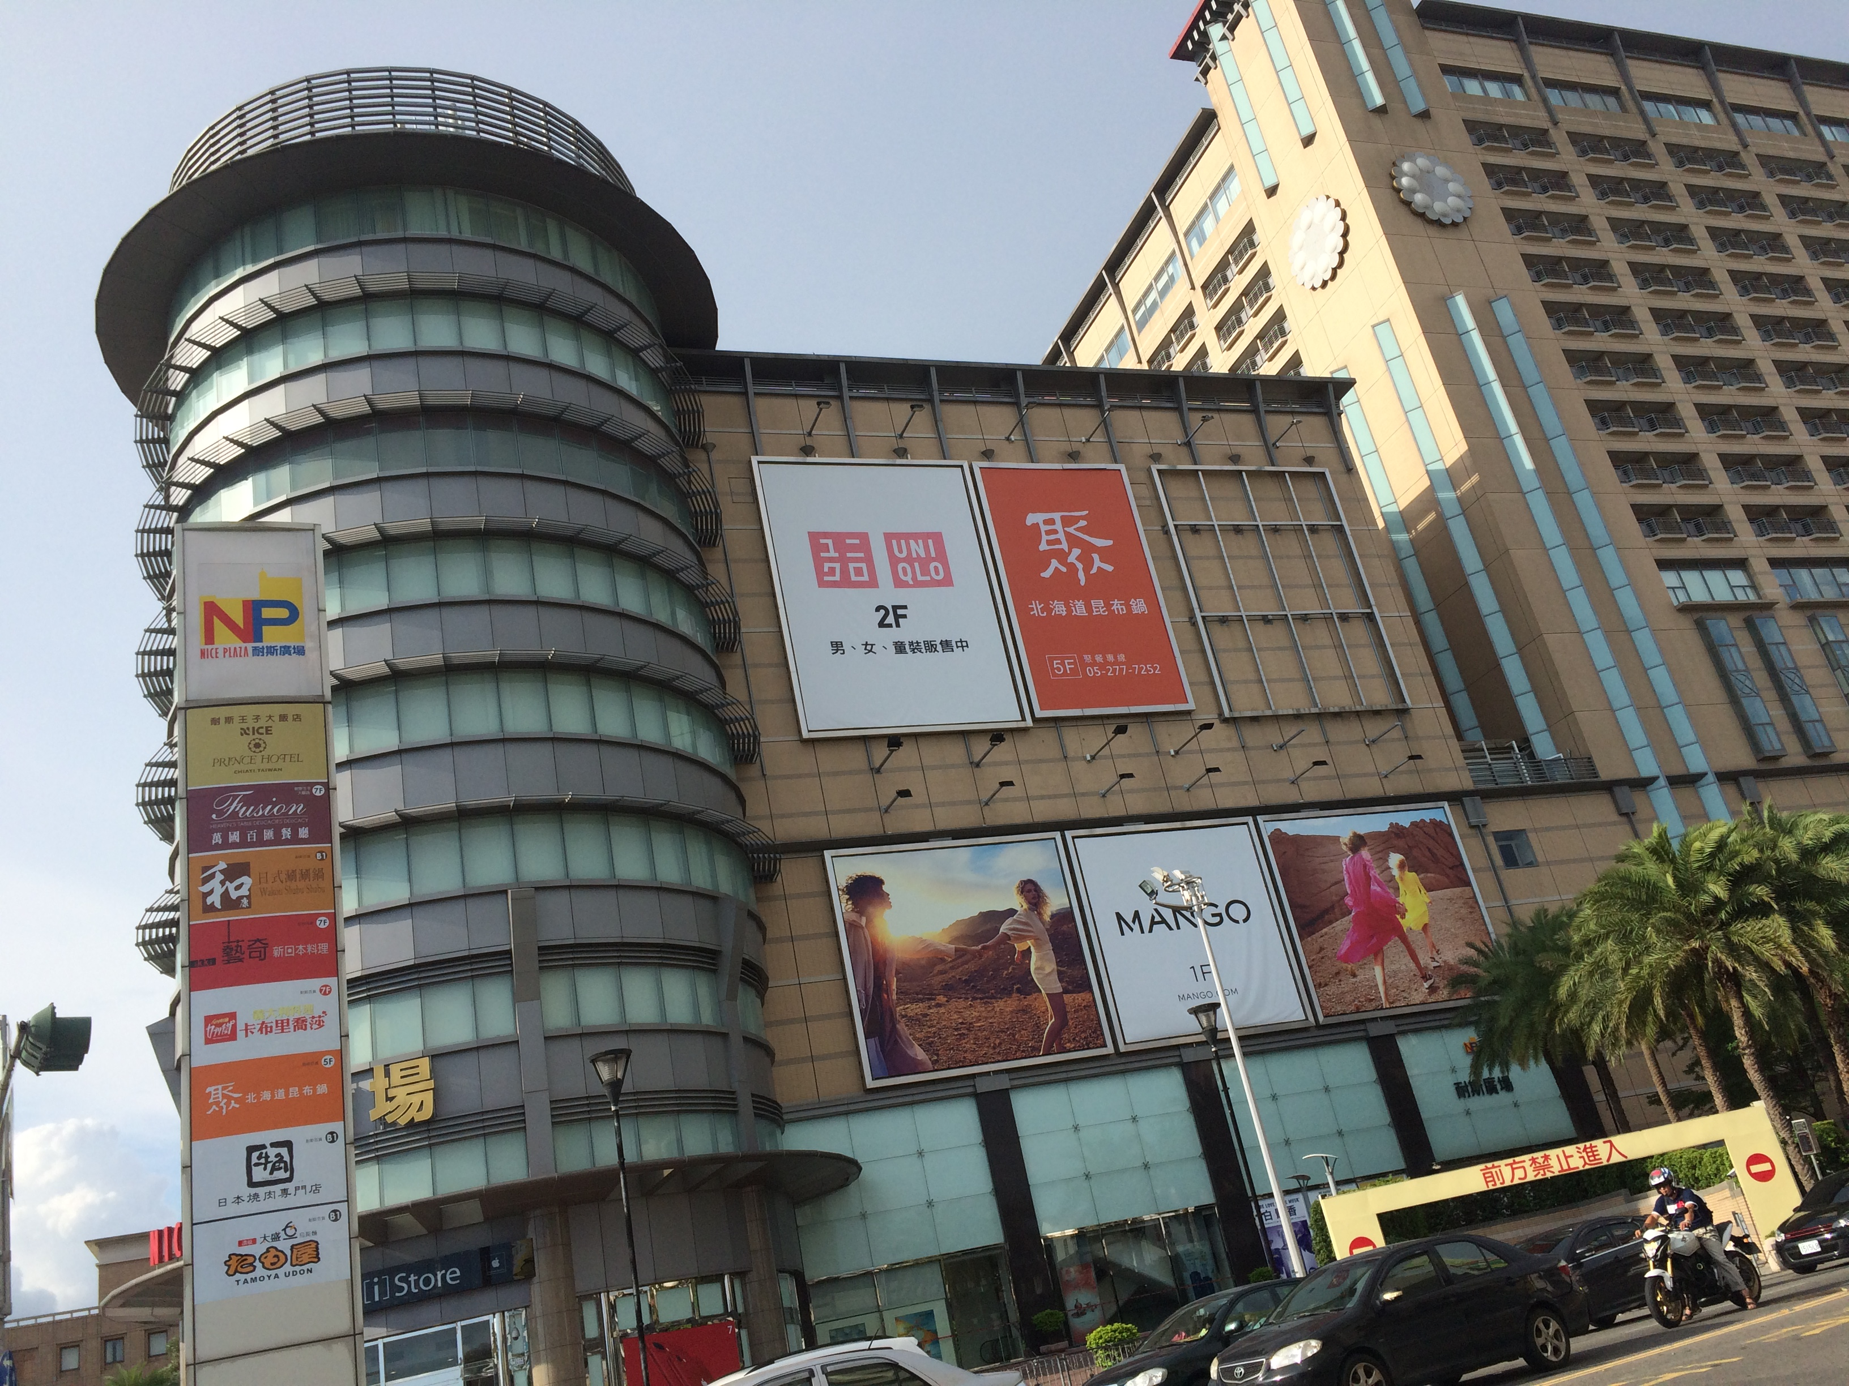
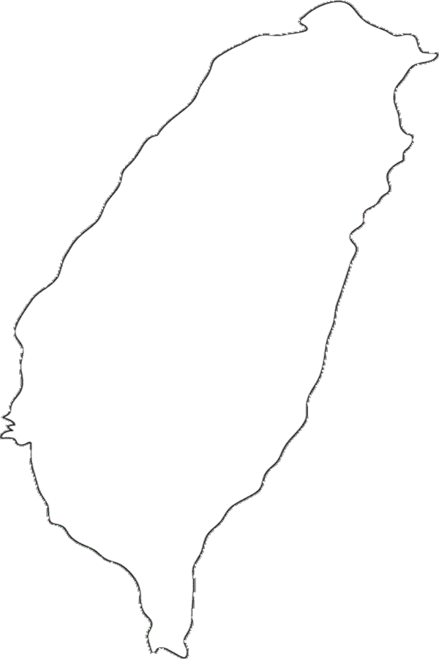
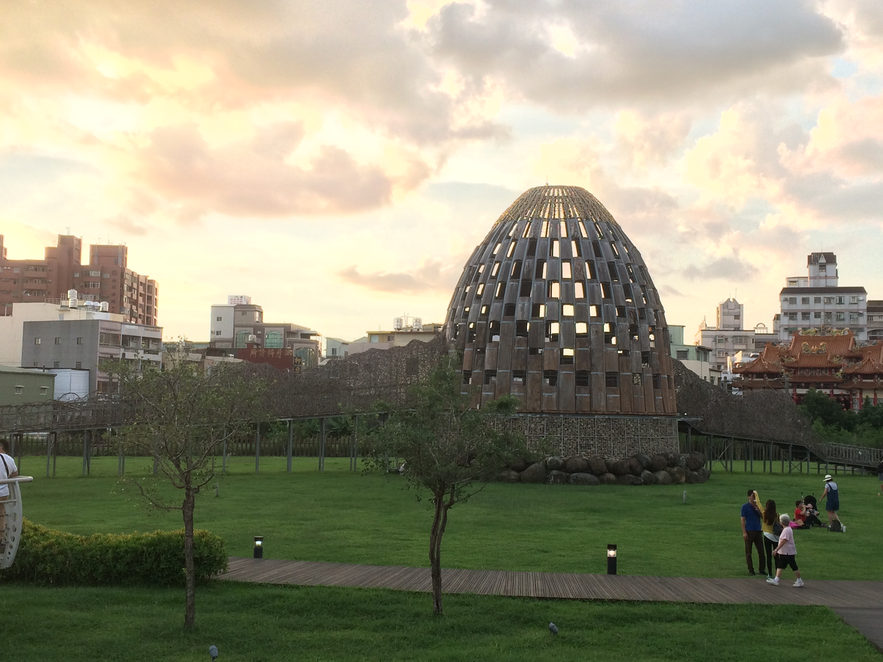
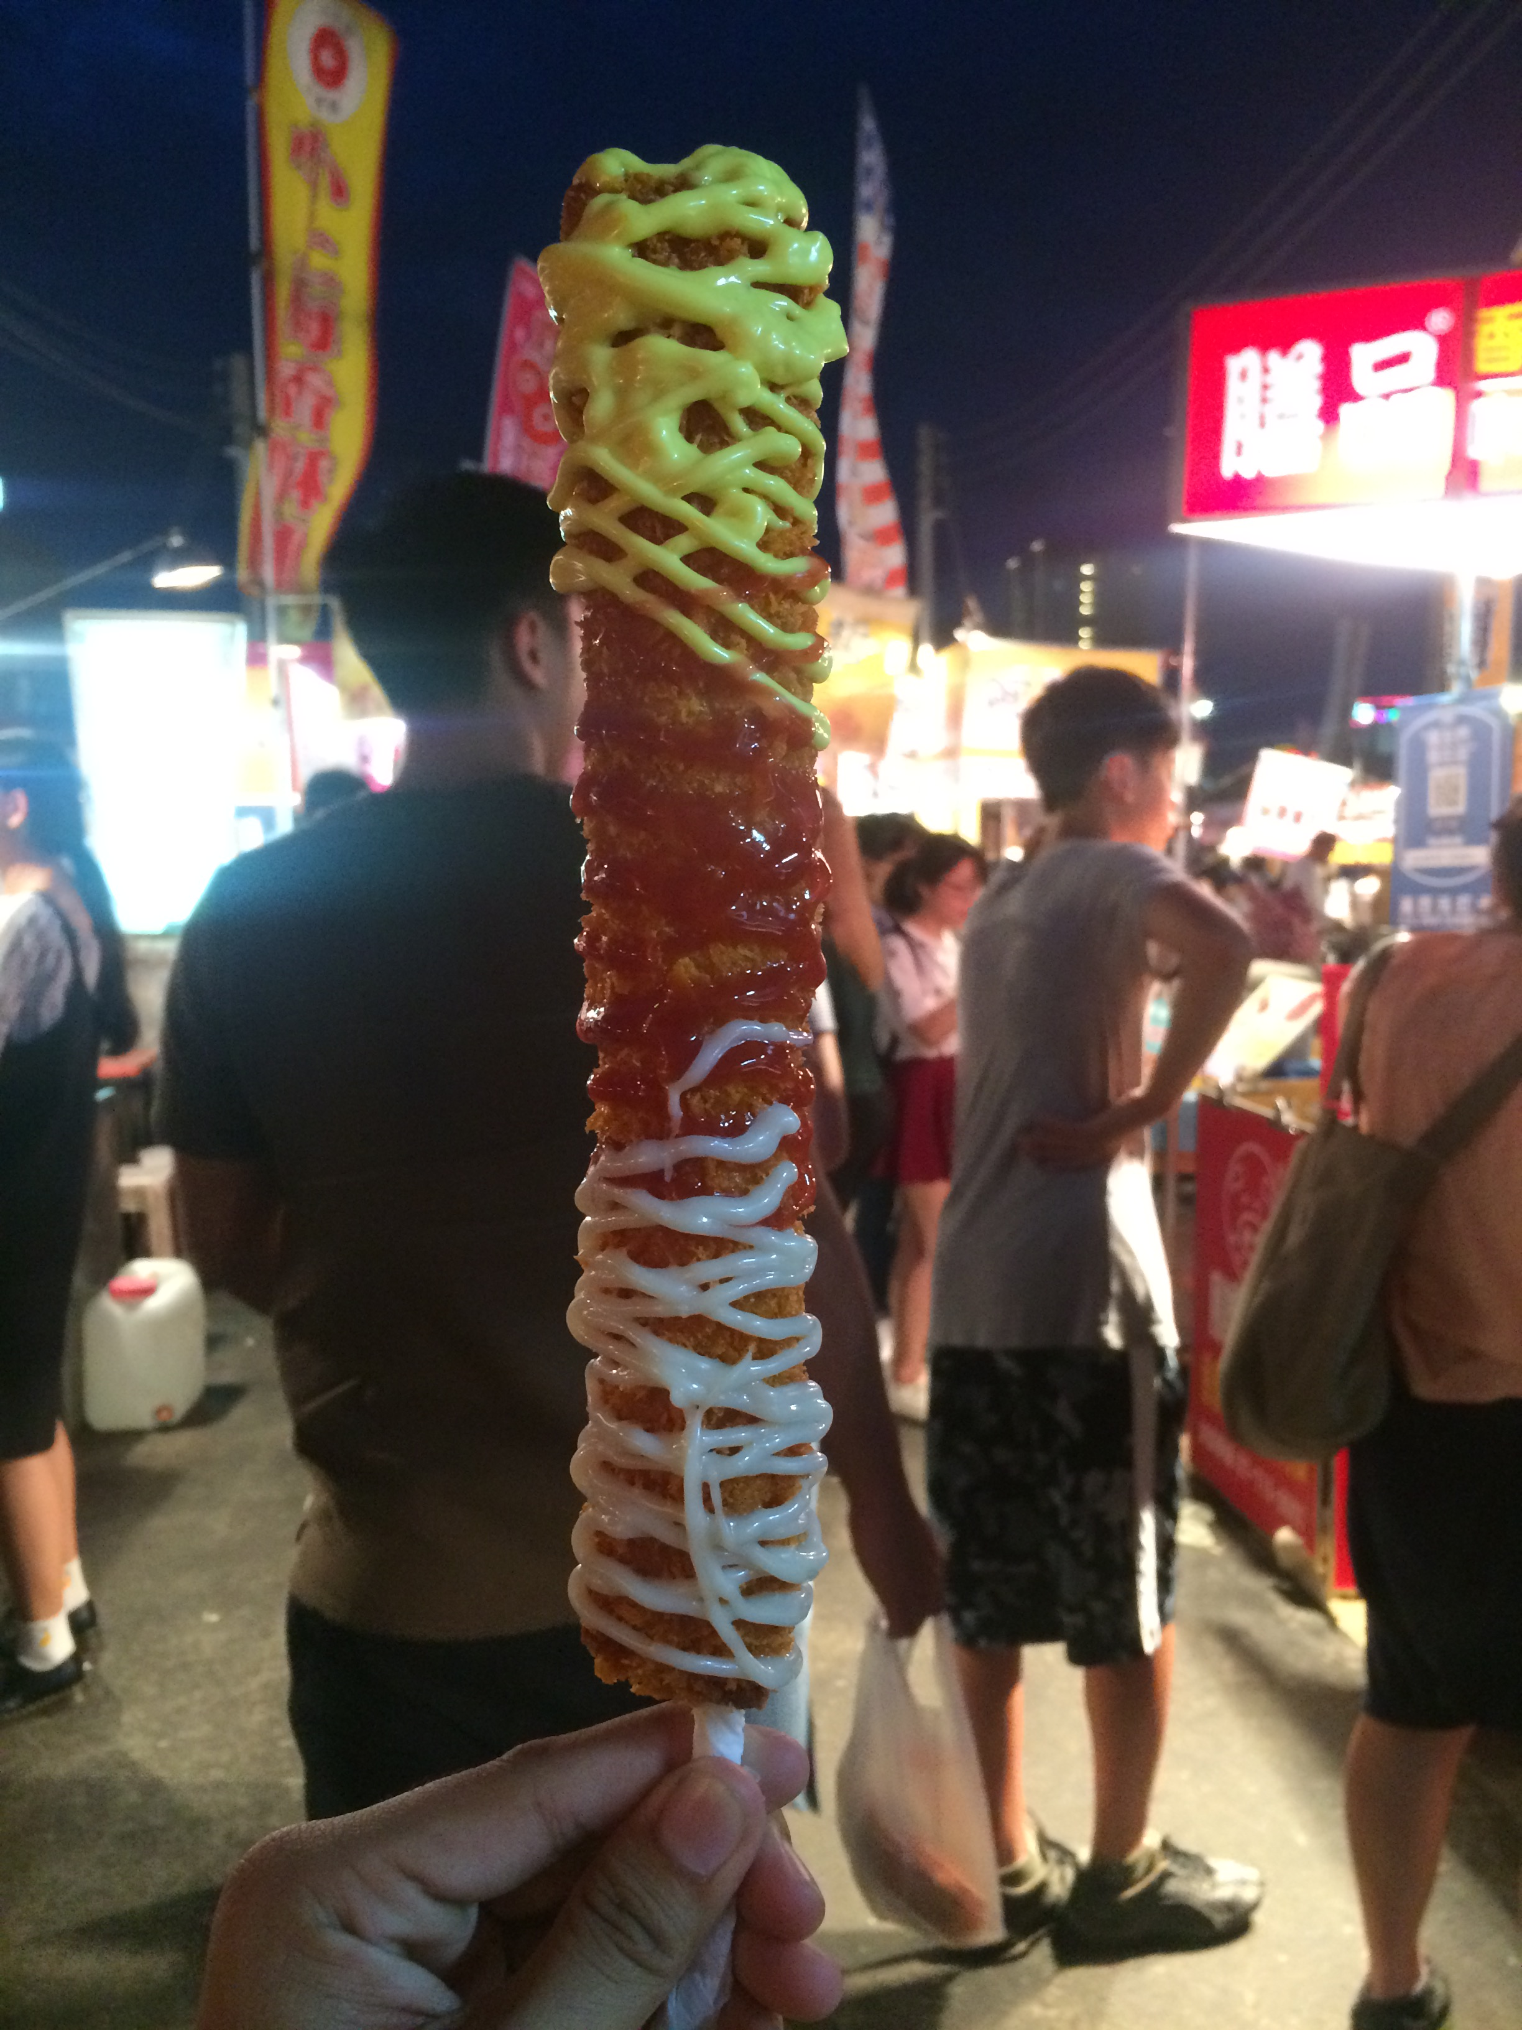
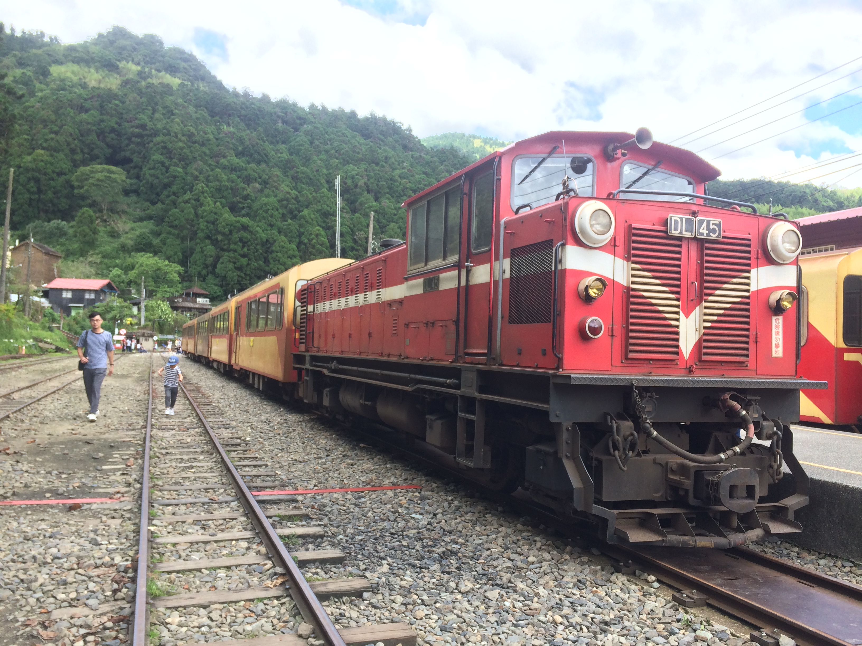
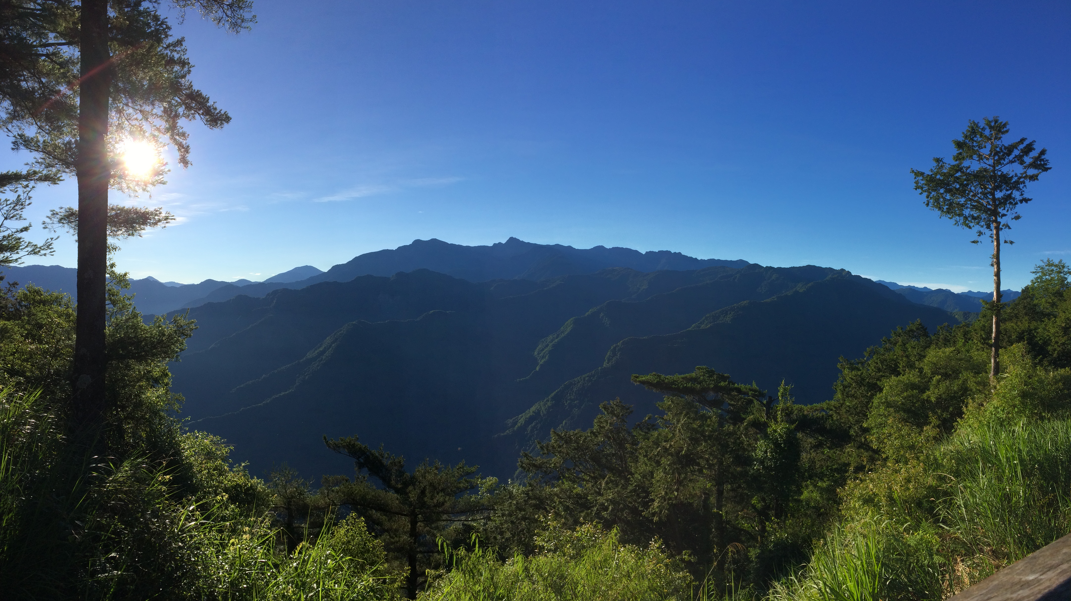
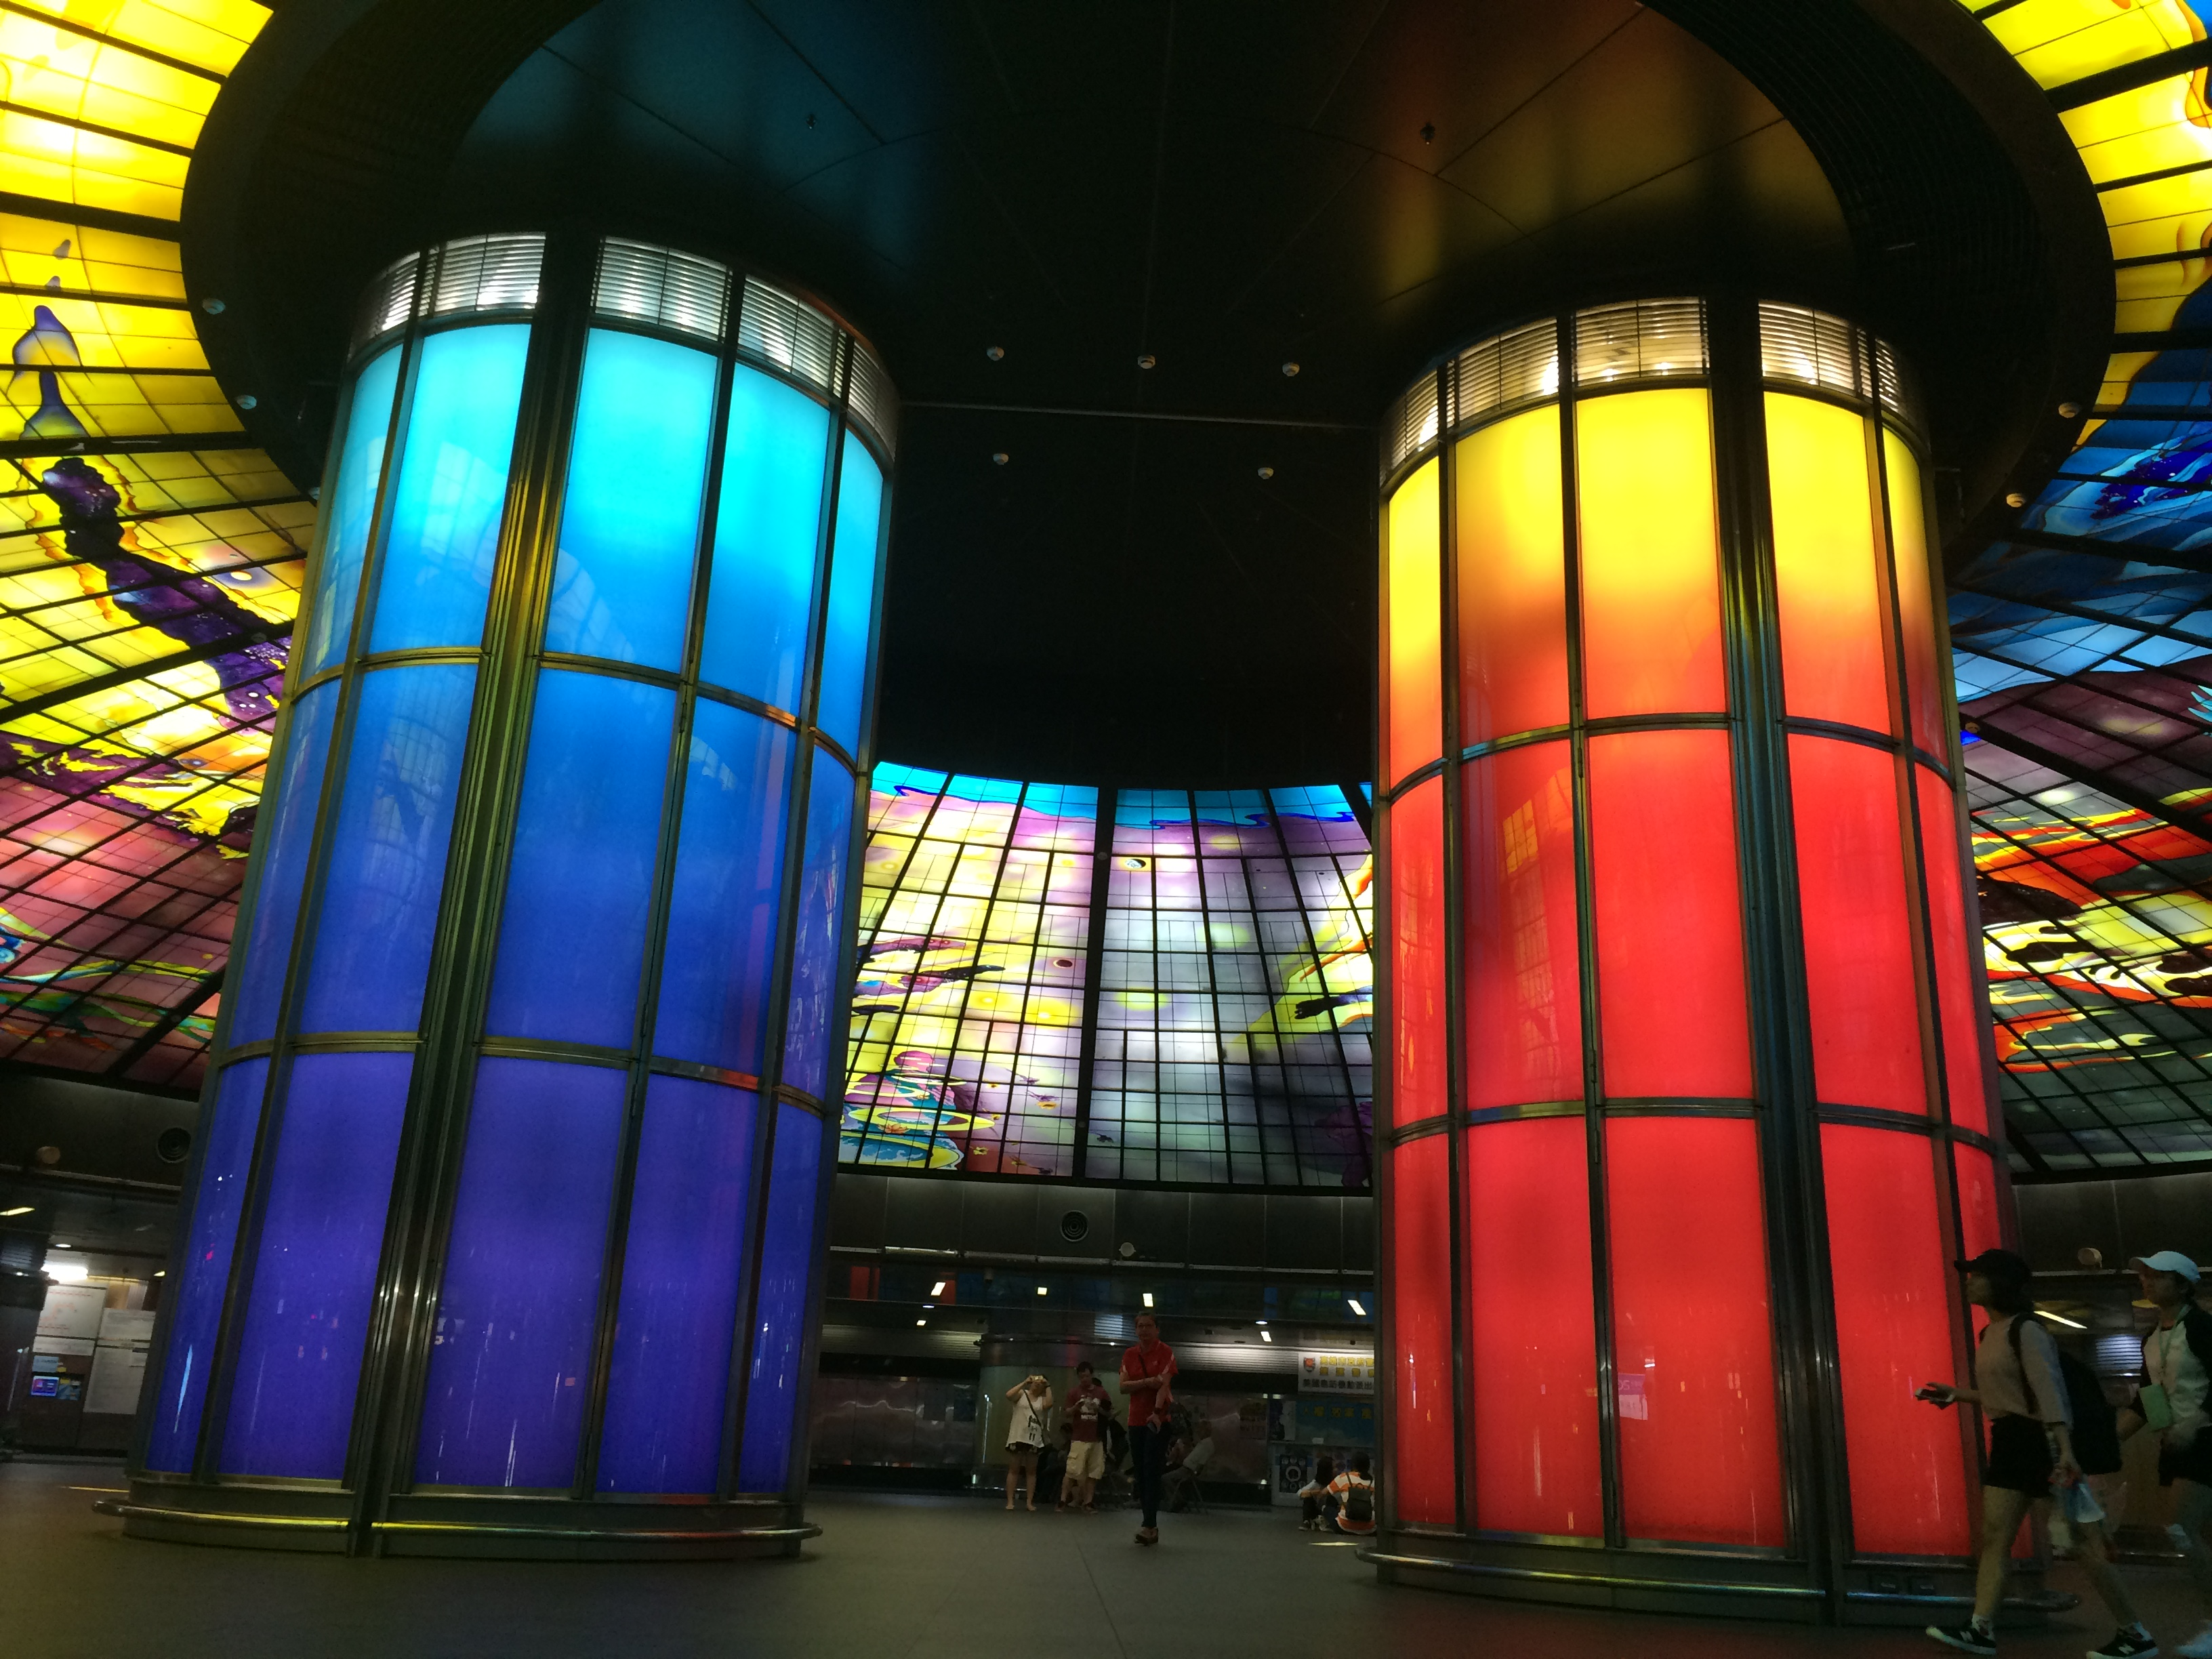
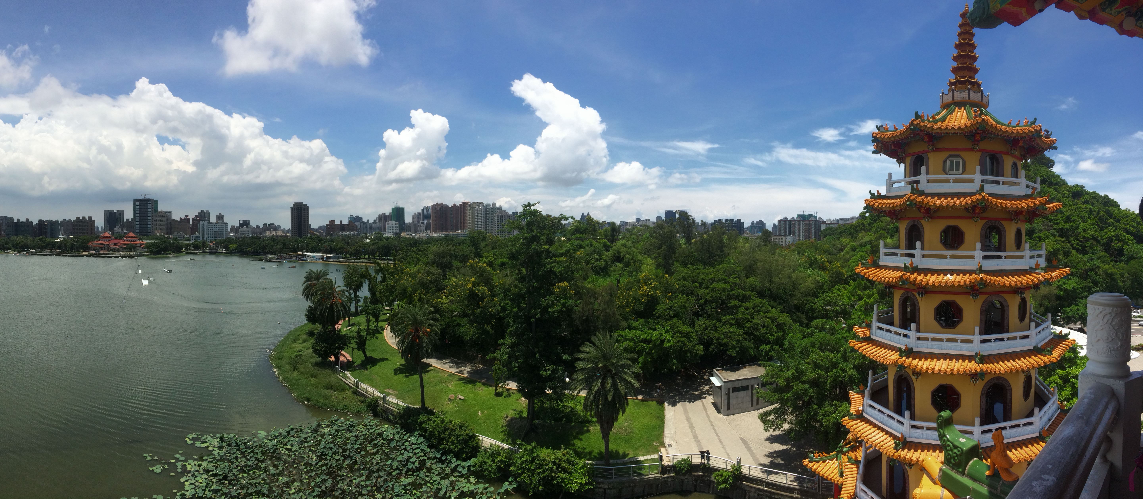
Travel Maps
Taipei
Tainan
Chiayi
Alishan
Kaohsiung

Slide 16

Thanks!
Any questions?

